Slide 1

Optimizing the Social Force Model
Quy Anh Nguyen
Ahmed Kallala
Smail Alijagic
Linus Baumberger
Notes:
LAYOUT: Title Slide · TIME: ~0.5 min
GOAL: say the project number and ONE sentence on what the kernel computes.
DO keep your names; the ETH logo is already on this layout.

Slide 2
Problem & Algorithm
Input:
n_{p} (number of pedestrians)
n_{iter} (number of iterations)
Output:
New position and velocity of each pedestrian at each iteration, as influenced by the social forces
Runtime:
Θ(n_{iter} * n_{p}²)
for iter in 1..200:
for i in peds: # Θ(n_{p}²)
F = goal(i)
for j in peds, j != i: # Θ(n_{p})
F += repulse(i, j) # exp, sqrt
for B in walls:
F += wall(i, B)
v[i], x[i] = euler(F)
Notes:
LAYOUT: Title Only (merged) · TIME: ~1.5 min
GOAL: just enough so the cost analysis & roofline make sense. DON’T derive or prove anything.
The course allows up to 2 algorithm slides — we use 1 to leave room for 3 optimizations.

Slide 3
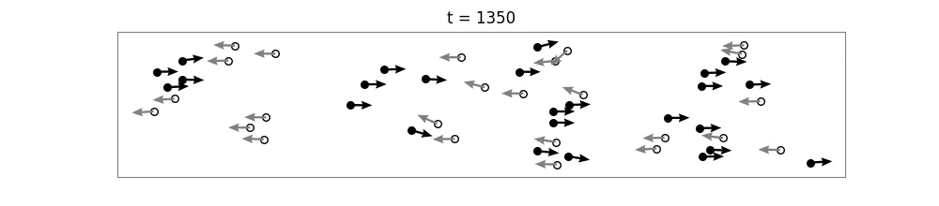
Testing & Validation
Test Suite
Visual Simulation
make verify
Notes:
LAYOUT: Title Only (merged) · TIME: ~1.5 min
GOAL: just enough so the cost analysis & roofline make sense. DON’T derive or prove anything.
The course allows up to 2 algorithm slides — we use 1 to leave room for 3 optimizations.

Slide 4
Performance Bounds & Cost Analysis
Peak Performance:
x86
  π_{scalar} 6 = flops/cycle
  π_{avx256_double} = 24 flops/cycle
  π_{avx256_float} = 48 flops/cycle
  π_{avx512_double} = 24 flops/cycle (halved due to 256-bit FPU datapaths)
  π_{avx512_float} = 48 flops/cycle (halved due to 256-bit FPU datapaths)
ARM
  π_{scalar} = 8 flops/cycle
  π_{neon_double} = 16 flops/cycle
  π_{neon_float} = 32 flops/cycle
Notes:
LAYOUT: Title + Content · TIME: ~1.5 min
GOAL: set up the roofline. SELF-CHECK: if any bound exceeds peak, you made an arithmetic error.
Common ASL traps: flops/byte vs flops/double (×8); summing shared ports instead of the bottleneck; forgetting write-allocate misses.

Slide 5
Performance Bounds & Cost Analysis
Cost Measure:
  C_{add} = C_{mult} = C_{div} = C_{sqrt} = 1 flop
  C_{exp} = 30 flops
Flop Count: W(n) = 72 · n_{p}(n_{p} - 1) + Θ(n_{p}) flops/iter ≈ 1.8e9 @ n_{p} = 5000
(per pedestrian pair: 14 ADD, 24 MULT, 1 DIV, 3 SQRT, 1 EXP)
Memory Traffic: Q(n) = 128 · n_{p} + 2 · sizeof(Obstacle) = 128 · n_{p} + 112 bytes/iter (double)
        = 64 · n_{p} + 2 · sizeof(Obstacle) = 64 · n_{p} + 56 bytes/iter (float)
(for simplicity, assume all data is read once and then permanently cached)
Operational Intensity: I = W/Q ≈ 2.8e3 flops/byte (double) @ n_{p} = 5000
        => I grows linearly with n_{p}.
        => Compute-bound for all n_{p}.
Costly operations, i.e. exp() and sqrt(), are serially dependent in the baseline, resulting in high latency.
Notes:
LAYOUT: Title + Content · TIME: ~1.5 min
GOAL: set up the roofline. SELF-CHECK: if any bound exceeds peak, you made an arithmetic error.
Common ASL traps: flops/byte vs flops/double (×8); summing shared ports instead of the bottleneck; forgetting write-allocate misses.

Slide 6
Optimization Roadmap (x86)
Baseline: 2.4% of π_{avx512_float} (1.15 flops/cycle)
Each version = ONE idea, applied cumulatively:
  v1 – Vectorization (inlining + SoA + SIMD): 3.06 flops/cycle, 6.38 % peak
  v2 – Transcendental Approximations (poly-exp, rsqrt, FTZ): 14.22 flops/cycle, 29.63% peak
  v3 – Extra Parallelism (float, AVX-512, ILP): 24.15 flops/cycle (best), 50.31% peak
Notes:
LAYOUT: Title + Content · TIME: ~0.5 min
GOAL: the big picture + baseline % of peak in one line. This replaces a separate baseline slide.
Make clear the versions STACK (v3 = v1+v2+v3) so the results plot reads as a cumulative climb.

Slide 7
Optimization Overview (x86)
Performance and speedup over baseline @ n_{p} = 5000
Optimization | Technique | Flops/Cycle | Speedup
Baseline | scalar, double | 1.1 | 1.0
Vectorization (Inlining + SoA and/or SIMD)
AVX2 | double, 4-wide | 3.1 | 2.7
AVX2 | float, 8-wide | 4.0 | 3.5
AVX-512 | double, 8-wide | 4.3 | 3.8
Transcendental Approximations
+ poly-exp | double, exp approximation using 5th-degree Taylor polynomials, FTZ | 7.1 | 6.2
+ poly-exp | float | 11.9 | 10.4
+ fast rsqrt | float, rsqrt (instead of sqrt) | 14.2 | 12.4
Conversion to Floats + ILP
+ float + AVX-512 + poly-exp | 16-wide | 17.8 | 15.5
+ more rsqrt + ILP | best variant | 24.1 | 21.0
Explored Alternatives
Distance cutoff | skip far-away pedestrian pairs | 1.7 | 1.5
LUT for exp() | look-up table + Hermite approximation | 1.2 | 1.0
Force symmetry | half the pedestrian pairs | 0.8 | 0.7

Slide 8
Optimization Overview (ARM)
Performance and speedup over baseline @ n_{p} = 5000
Optimization | Technique | Flops/Cycle | Speedup
Baseline | scalar, double | 1.5 | 1.0
Vectorization (SoA + SIMD)
float + NEON + poly-exp + fast rsqrt + ILP | NEON reimplementation of the best x86 variant | 10.5 | 7
Explored Alternatives
Distance cutoff | skip far-away pedestrian pairs | 4.7 | 3.1
LUT for exp() | look-up table + Hermite approximation | 2.4 | 1.6
Force symmetry | half the pedestrian pairs | 1.3 | 0.8

Slide 9
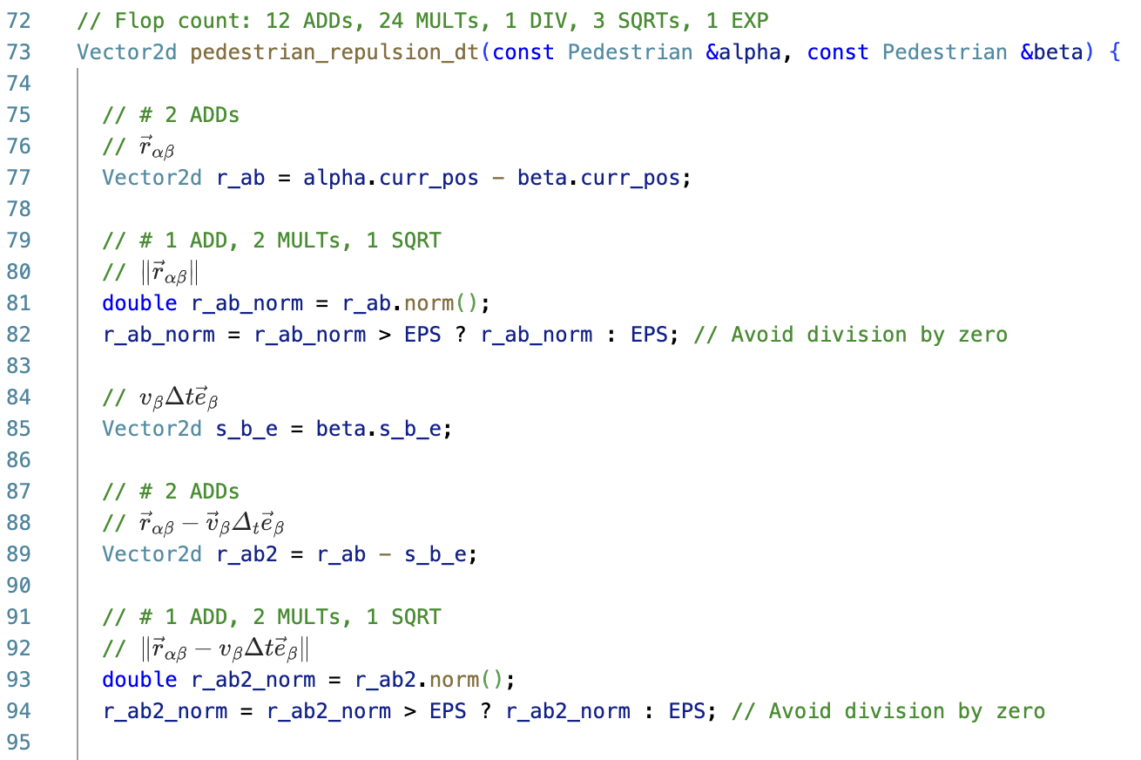
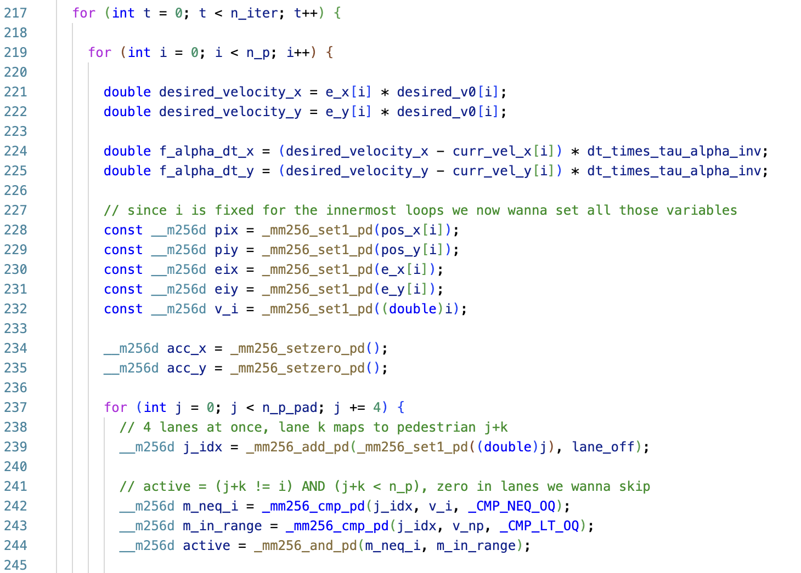
Optimization 1 - Vectorization (SoA + AVX)
Before
After
Notes:
LAYOUT: Title Only · TIME: ~1.5 min
GOAL: first optimization. Swap the example for your real one. End on this step’s speedup.

Slide 10
Optimization 2 - Cheaper Transcendentals
Before
After
scalar libm exp(), branching
degree-5 exp() approximation,
branchless intrinsics
libm sqrt(), explicit divisions
_mm512_rsqrt14_ps()
manually handling subnormals
FTZ / DAZ
Notes:
LAYOUT: Title Only · TIME: ~1.5 min
GOAL: second optimization. A single accumulator is latency-bound; several expose ILP.

Slide 11
Optimization 2 - Cheaper Transcendentals
scalar exp() + libm sqrt() + explicit div
poly-exp + rsqrt (vectorized)
plain FMAs
Dependency chain
Before
scalar libm exp()
exp: scalar libm - one lane at a time
exp() is the only non-vectorized operation left → the 8-wide loop runs at scalar-exp speed
Dependency chain
After
vectorized exp() approximation
≈ 3.6× faster
poly-exp runs on all lanes; rsqrt replaces the libm sqrt() + div
colored bars = inner-loop durations
After (partial) vectorization, the bottleneck remained the scalar exp() calls.
Degree-5 exp() approximation + branchless intrinsics
Replacing sqrt + div with rsqrt
Flushing subnormals down to zero instead of triggering microcode assists -> Avoid 100-cycle stalls
Notes:
LAYOUT: Title Only · TIME: ~1.5 min
GOAL: second optimization. A single accumulator is latency-bound; several expose ILP.

Slide 12
Optimization 3 – Extra Parallelism
BEFORE
AFTER
4 doubles per vector
16 floats per vector
K = 1, L = 1
K = 2, L = 32
Notes:
LAYOUT: Title Only · TIME: ~1.5 min
GOAL: third optimization. Watch the regime shift — vectorizing a compute-bound kernel can make it memory-bound.
Reorder these three to match YOUR actual optimizations; the locality→ILP→SIMD order is just a common one.

Slide 13
Optimization 3 - Extra Parallelism
double
4 × 64-bit (AVX-256)
x4 elements / instruction
π: 24 → 48 flops/cycle
float
16 × 32-bit (AVX-512)
+ halved memory footprint: 128 -> 64 bytes/pedestrian
Switching to floats is a double bonanza: double the vector elements and half the memory footprint
With a smaller memory footprint, we can store more pedestrians in cache.​
Trade-off: Precision reduced from ~16 digits (double) to ~7 digits (float).
=> Overall speedup: 2.7 @ n_{p} = 5000
Notes:
LAYOUT: Title Only · TIME: ~1.5 min
GOAL: third optimization. Watch the regime shift — vectorizing a compute-bound kernel can make it memory-bound.
Reorder these three to match YOUR actual optimizations; the locality→ILP→SIMD order is just a common one.

Slide 14
NEON Reimplementation (best x86 variant)
4 × elements / instruction
π: 32 flops/cycle
float
4 × 32-bit
Speedup vs. baseline: ≈7 @ n_{p} = 5000
16-wide AVX-512 → 4-wide NEON
Same optimizations as best x86 variant: SoA, masking, poly-exp, FTZ, and ILP @ K = 2
Peak performance ≈ 10.5 FLOPs/cycle (~33% π)
Validated against double baseline (n_{p} = 60, n_{iter} = 4000): Positions stayed within ~7 cm.
Notes:
LAYOUT: Title Only · TIME: ~1.5 min
GOAL: third optimization. Watch the regime shift — vectorizing a compute-bound kernel can make it memory-bound.
Reorder these three to match YOUR actual optimizations; the locality→ILP→SIMD order is just a common one.

Slide 15
Experimental Results (x86)
Notes:
LAYOUT: Title Only · TIME: ~1.5 min
GOAL: the main evidence — and that it is TRUSTWORTHY. State HOW you measured (cycles, turbo off, cold/warm cache, median of N) and that you VALIDATED correctness vs the baseline — the professor WILL ask.
DO push sizes past the last cache level so the memory-bound regime shows.
L2 size still has to be drawn here

Slide 16
Analysis: Roofline
Notes:
More like a placeholder, this still has to be verified and extended

Slide 17
Conclusions
Highest Achieved Speedup: 21 (1.2 → 24 flops/cycle)
Biggest Gains:
  Transcendental Approximations
  Double -> Single Precision
Hitting Bounds: Compute throughput & instruction mix
Notes:
LAYOUT: Title + Content · TIME: ~0.5 min
GOAL: land on a NUMBER, not “thank you, questions?”. Then take Q&A.

Slide 18
Appendix
Speedup Summary (x86)
Speedup Summary (ARM)
Speedup Milestones

Slide 19
Speedup Summary (x86)
speedup = variant_cycle_count / baseline_cycle_count @ n_{iter} = 200
Variant | Speedup | Cycles (billions)
Reference
baseline — scalar double | 1.00 | 313.4 | ref
scalar float | 0.85 | 368.7 | slower
Scalar tweaks
branchless | 0.81 | 385.6 | slower
branchless, sqrt-free | 1.02 | 308.1 | neutral
LUT for exp() | 1.02 | 306.2 | no gain
cutoff | 1.44 | 217.5 | approx
cutoff (callsite) | 1.47 | 213.6 | best scalar
Double · AVX2
AVX2 | 2.67 | 117.5
AVX2 + polyexp | 4.45 | 70.4
Double · AVX-512
AVX-512 | 3.76 | 83.3
AVX-512 + polyexp | 6.16 | 50.8 | best double
+ ILP @ K = 2 | 6.12 | 51.2 | no gain
+ fastinvsqrt | 6.15 | 51.0 | ≈ rsqrt
+ fastinvsqrt + scalar replacements | 6.10 | 51.4
Variant | Speedup | Cycles (billions)
Float · AVX2
AVX2 | 3.46 | 90.5
AVX2 + polyexp | 10.37 | 30.2
+ rsqrt | 12.38 | 25.3
+ rsqrt + loopopt | 13.61 | 23.0 | best AVX2
Float · AVX-512
AVX-512 + polyexp | 15.27 | 20.5
+ fastinvsqrt | 15.33 | 20.4 | ≈ rsqrt
+ moreavx | 15.51 | 20.2
+ moreavx + ILP @ K = 2 | 16.47 | 19.0
+ moreavx + ILP @ K = 2 + moreilp | 16.51 | 19.0
+ moreavx + ILP @ K = 4 | 15.66 | 20.0 | regressed
+ moreavx + ILP @ K = 2 + rsqrt | 16.42 | 19.1
+ ILP @ K = 2 + rsqrt + morersqrt | 21.02 | 14.9 | BEST
Symmetry — half the pairs
symmetry, scalar | 1.40 | 223.3
symmetry, scalar + ILP @ K = 2 | 0.97 | 323.2
symmetry, float | 0.90 | 346.7
symmetry, float + ILP @ K = 2 | 1.09 | 287.9
symmetry, float + ILP @ K = 4 | 1.31 | 238.5
symmetry, float + ILP @ K = 8 | 1.52 | 206.6 | best symmetry
symmetry, float + ILP @ K = 16 | 1.43 | 219.0
Not all variants have the same flop count, so the above table compares them using their runtime instead.

Slide 20
Speedup Summary (ARM)
speedup = variant_cycle_count / baseline_cycle_count @ n_{iter} = 200
Variant | Speedup | Cycles (billions)
Reference
baseline — scalar double | 1.00 | 233.7 | ref
scalar float | 1.20 | 194.3 | faster
Scalar tweaks
branchless | 1.40 | 167.4 | faster
branchless, sqrt-free | 1.41 | 166.3
LUT for exp() | 1.55 | 151.1 | faster
cutoff | 3.00 | 76.4 | best scalar
cutoff (callsite) | 2.94 | 79.4
Float · NEON
+ ILP @ K = 2 + rsqrt + morersqrt | 6.81 | 34.3 | BEST
Symmetry — half the pairs
symmetry, scalar | 0.84 | 276.7
symmetry, scalar + ILP @ K = 2 | 0.94 | 247.4
symmetry, float | 1.00 | 232.9
symmetry, float + ILP @ K = 2 | 1.52 | 154.0
symmetry, float + ILP @ K = 4 | 1.62 | 144.7 | best symmetry
symmetry, float + ILP @ K = 8 | 1.48 | 158.1
symmetry, float + ILP @ K = 16 | 1.50 | 156.2
Not all variants have the same flop count, so the above table compares them using their runtime instead.

Slide 21
Speedup Milestones

